Slide 1
Il meccanismo specchio
Università di Genova
Inaugurazione anno accademico 2017-2018
Genova, 11 novembre 2017

Slide 2
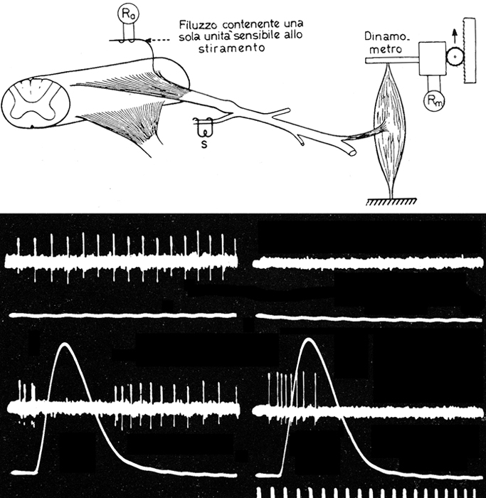

Slide 3
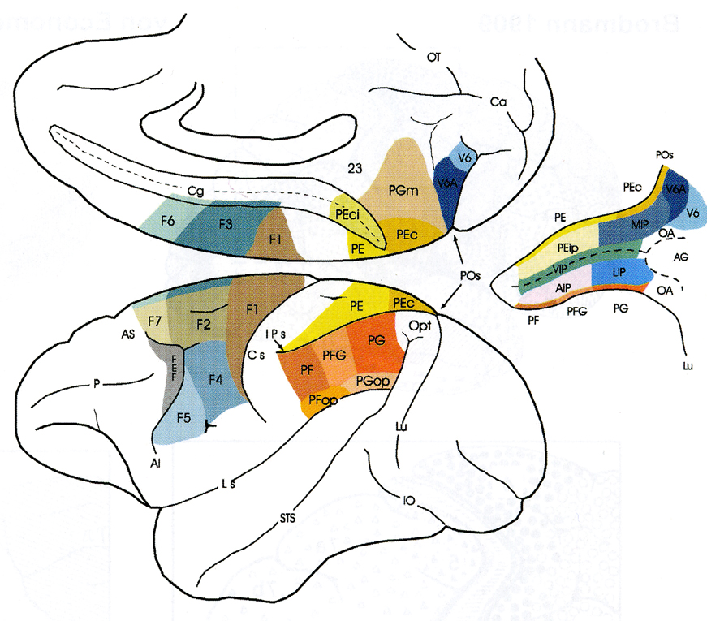

Slide 4
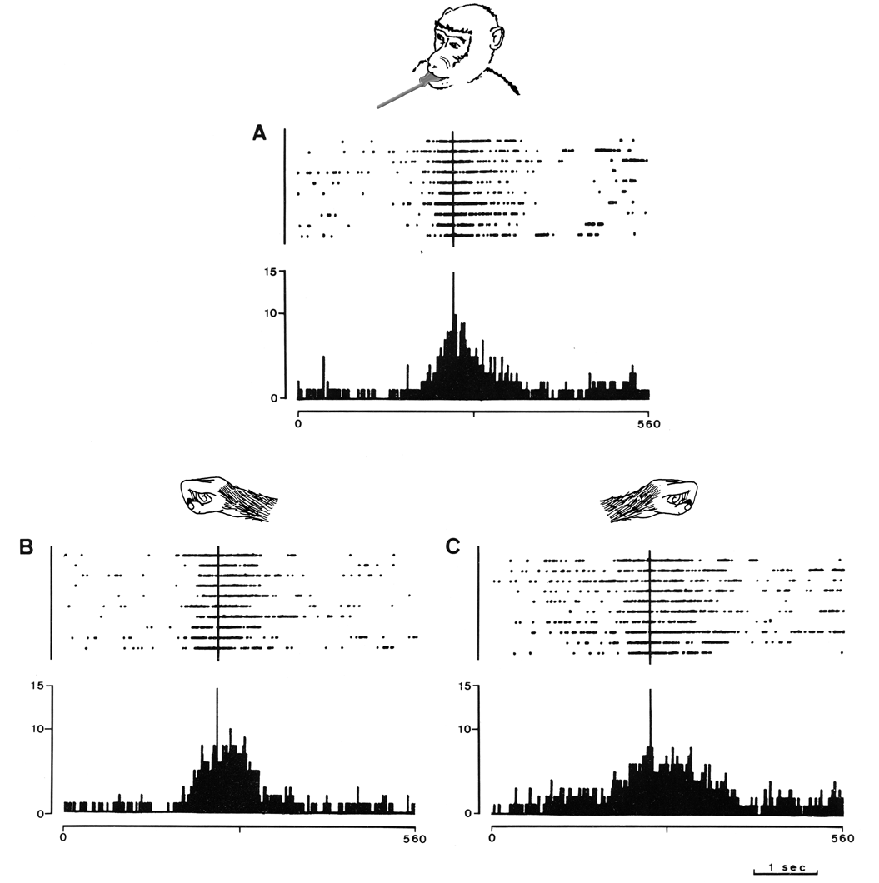

Slide 5
Visual properties of area F5

Slide 6
Premotor Area F5 = 676 Purely motor = 438 Canonical neurons = 108 Mirror neuron = 138

Slide 7
Mirror neurons

Slide 8
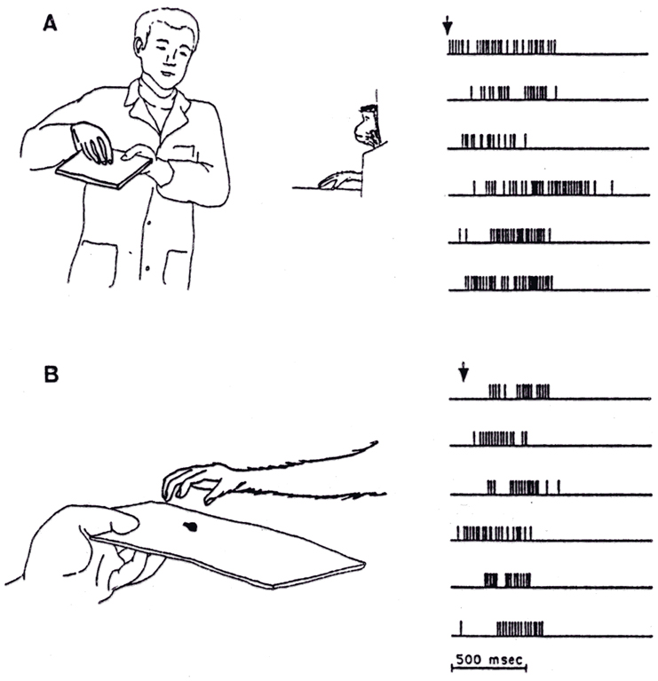

Slide 9
What is the functional role of mirror neurons in F5?

Slide 10
“A mere visual perception, without involvement of the motor system would only provide a description of the visible aspects of the movements of the agent, but it would not give precise information about the intrisic components of the observed action which are critical for understanding what the action is about, what is its goal, and how to reproduce it”.
from M. Jeannerod, Action from within , 2004

Slide 11
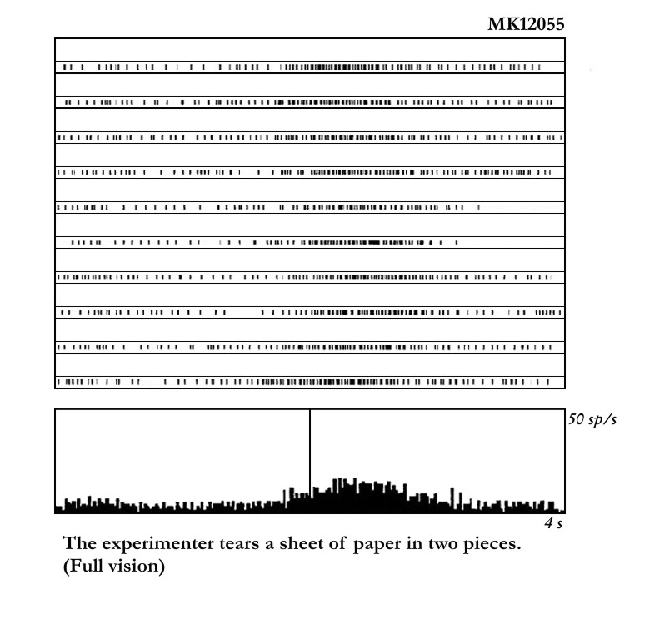

Slide 12
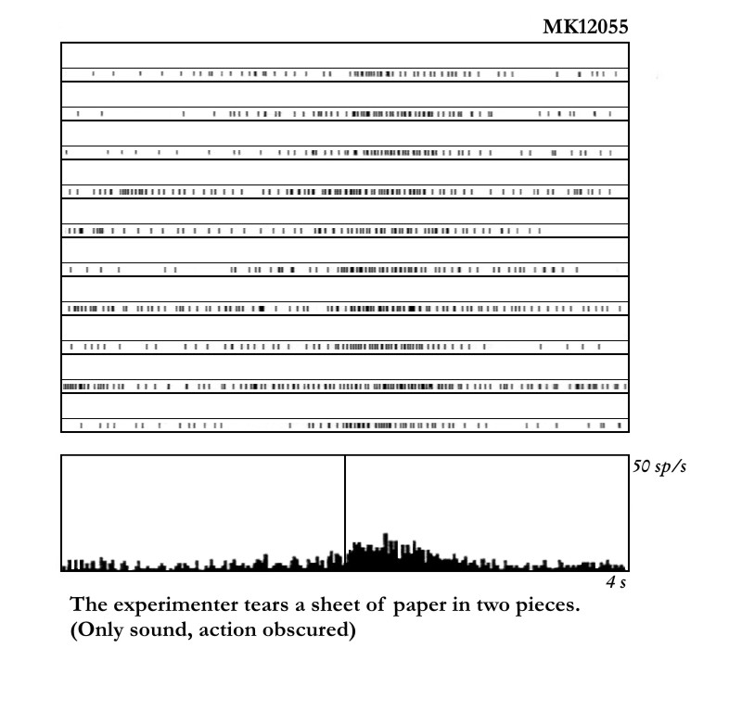

Slide 13
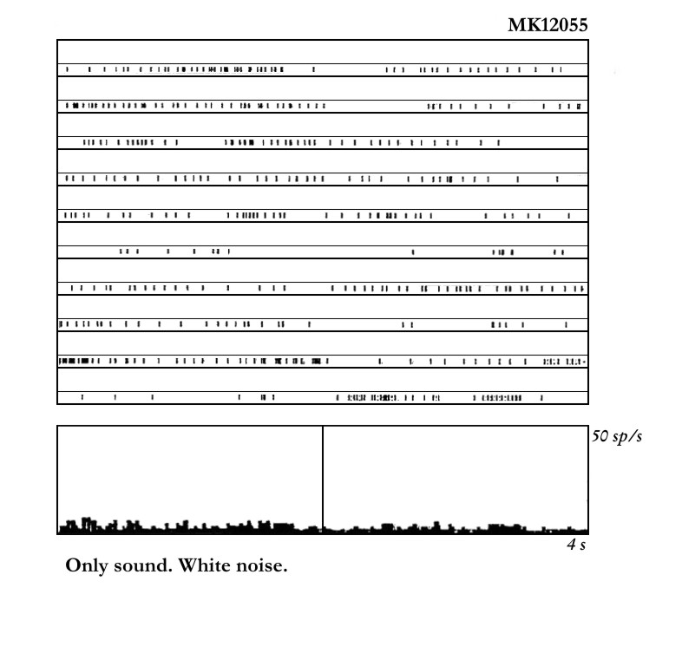

Slide 14
Brain imaging techniques

Slide 16
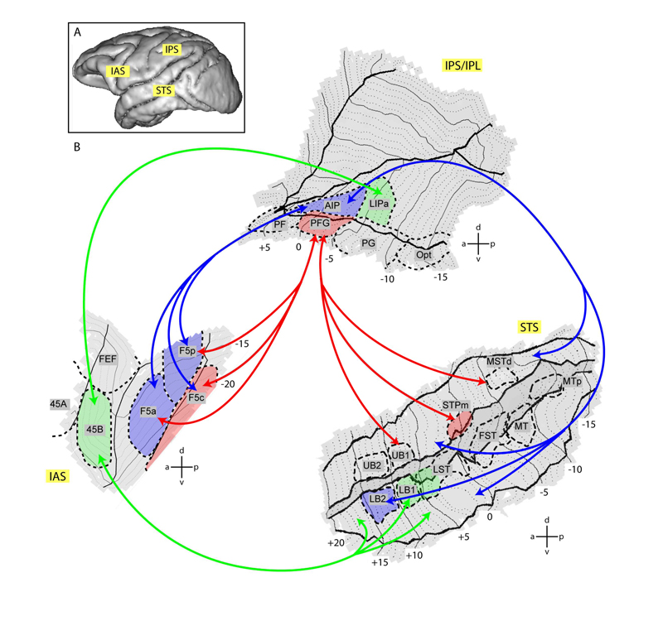

Slide 17
Brain imaging experiments in humans

Slide 18
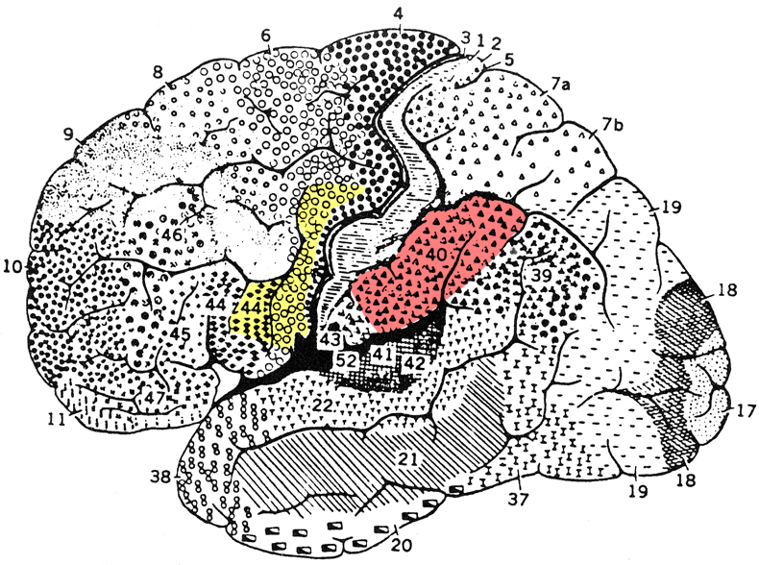

Slide 19
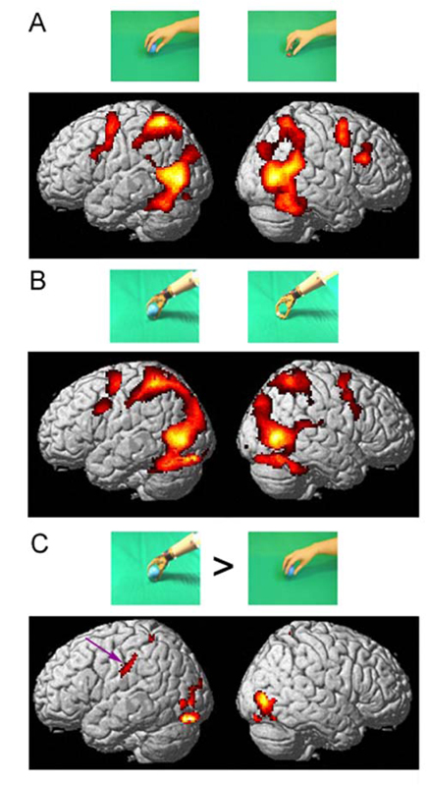

Slide 20
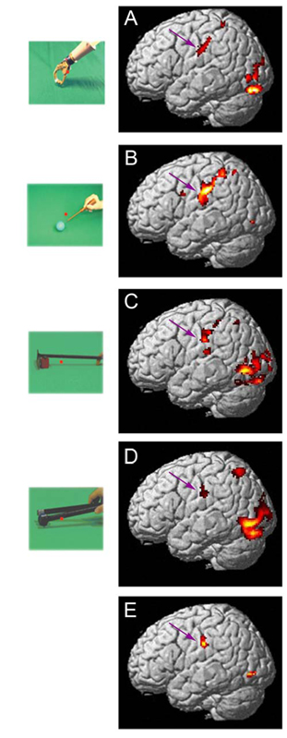

Slide 21
Tool use and ideomotor apraxia

Slide 22
Which are the actions that we understand using the mirror mechanism ?

Slide 23
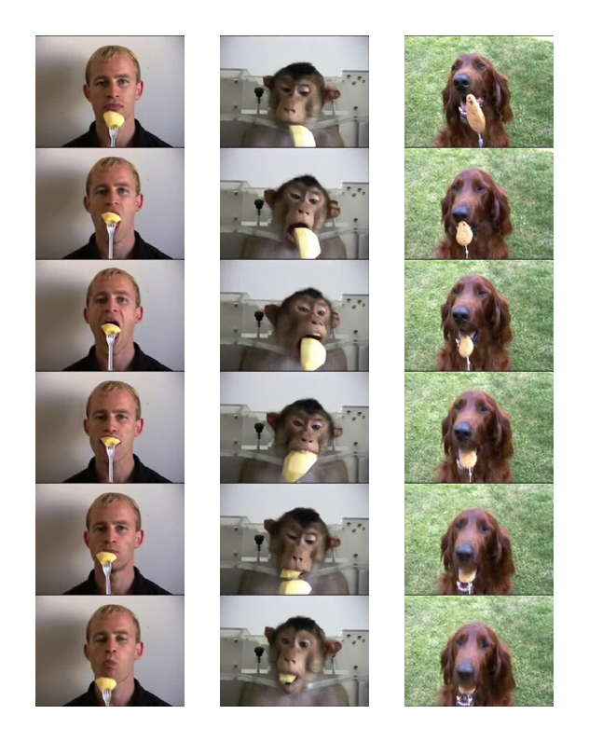

Slide 24
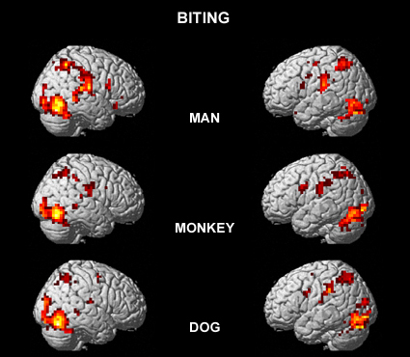

Slide 25
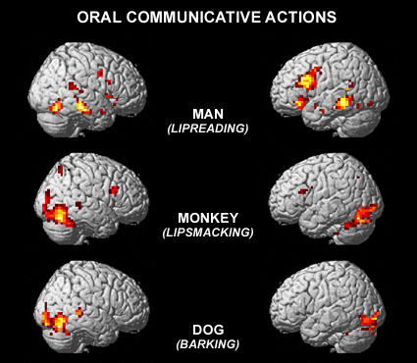

Slide 26
The insula

Slide 27
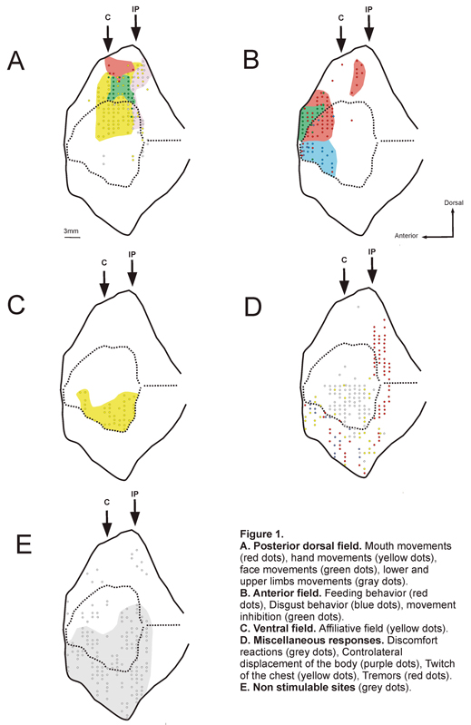

Slide 28
Disgust in humans

Slide 29
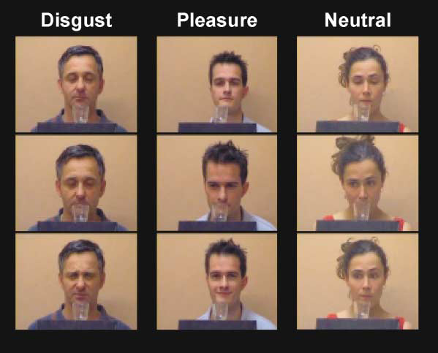
Wicker et al. Neuron 2003

Slide 30
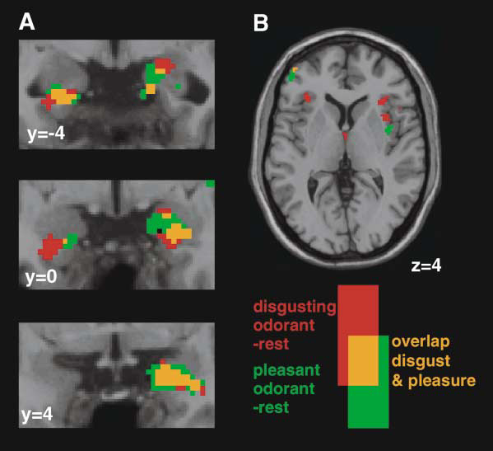
Wicker et al. Neuron 2003

Slide 31
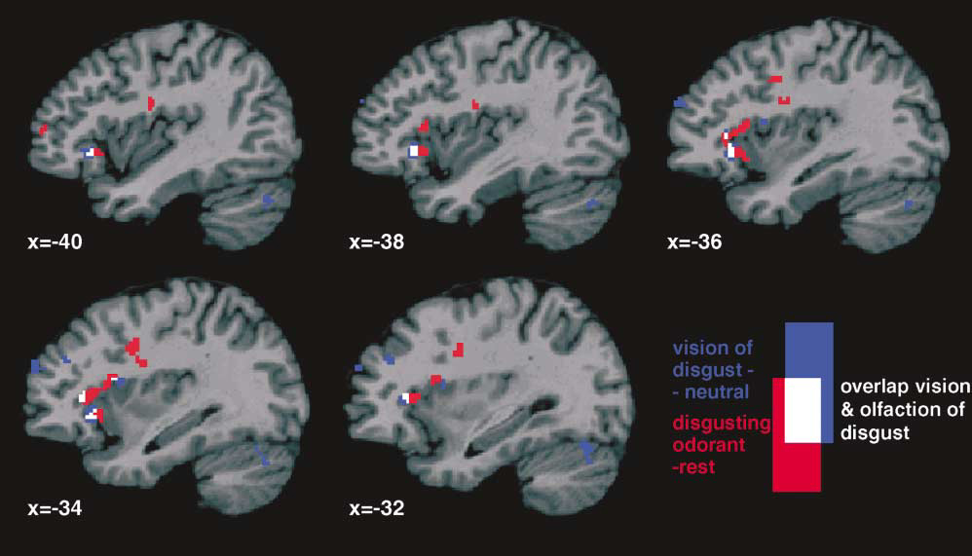

Slide 32
Stereo-EEG

Slide 33
Intracortical recordings
in humans
Pietro Avanzini Giacomo Rizzolatti
Fausto Caruana Ivana Sartori
Guy A. Orban Giorgio Lo Russo
,

Slide 34
La quarta dimensione

Slide 35
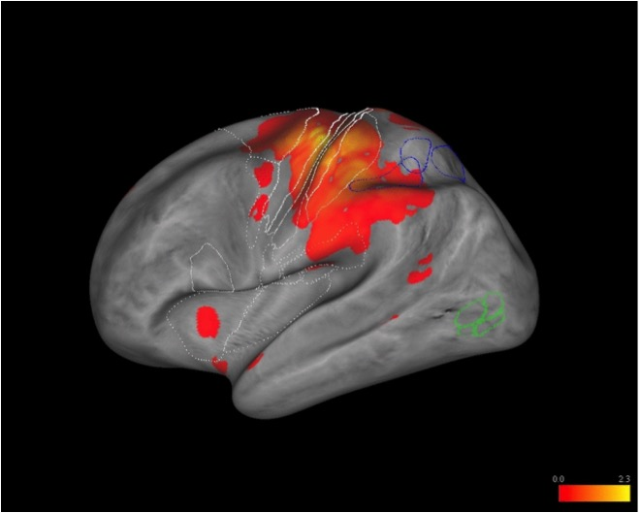
Neuroimaging map

Slide 36
Median nerve stimulation
Right Hemisphere
Left Hemisphere

Slide 38
Loughing

Slide 39
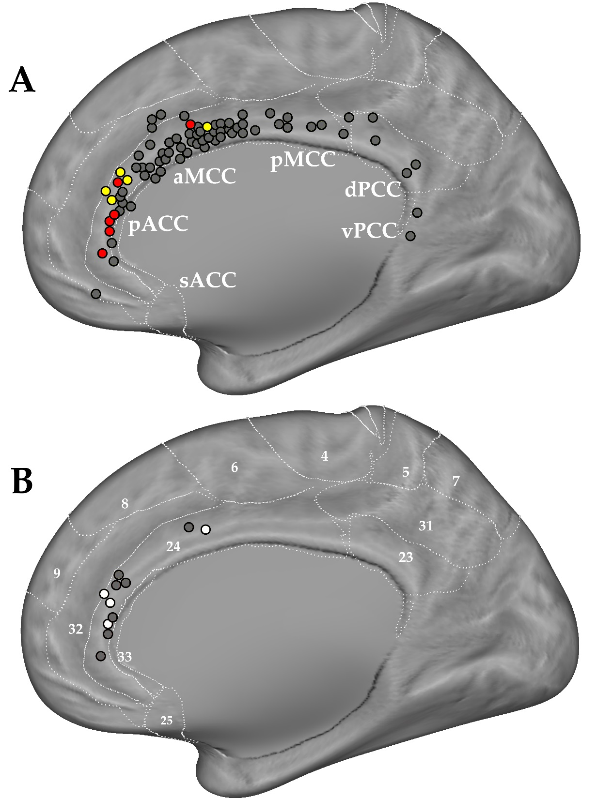

Slide 40
Gamma 50-150Hz time bins 250ms – time window -500 + 2000
Video Cry
Video Laughter
Video Neutral

Slide 41
The end

